Slide 1
Same logs, two outcomes
Lead: Ravindra Shukla
Legacy scores one user against a fixed line. Behavioral entities read the same logs in context — and catch all four stealth attacks.
LEGACY
BEHAVIORAL TWIN
RESULT
one user vs a threshold
same logs, in context
caught, with evidence
Single-user history only
Cohort-relative deviation
What a user HAS done
plus where they’re HEADING
Fixed alert thresholds
>
Self-drift over time
>
0 of 4 attacks flagged
Known-bad profile match
Evidence-backed, explainable
4 of 4 caught · 0 false positives
Why it matters
Point-anomaly tools saw normal employees; the behavioral twin named each attack by the behavior that gave it away.
CONFIDENTIAL | 22nd Century Technologies | EDM Vector Intelligence — Cyber UEBA
1

Slide 2
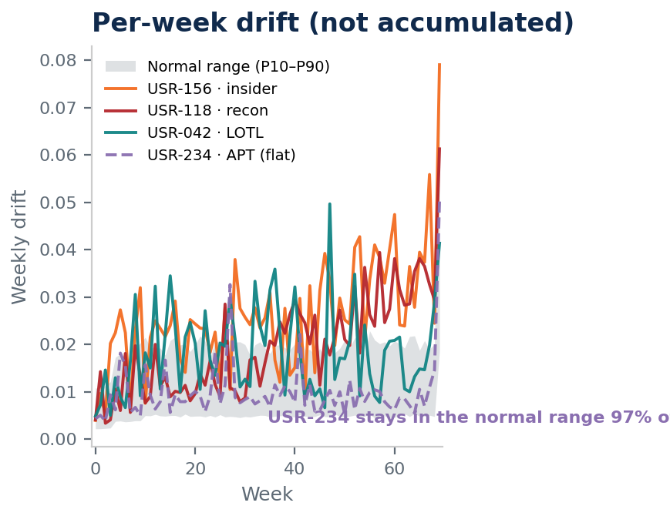
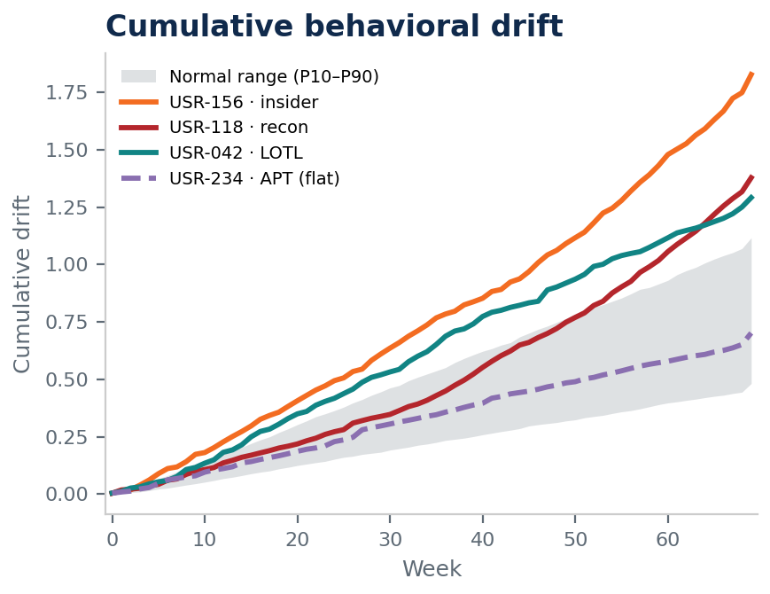
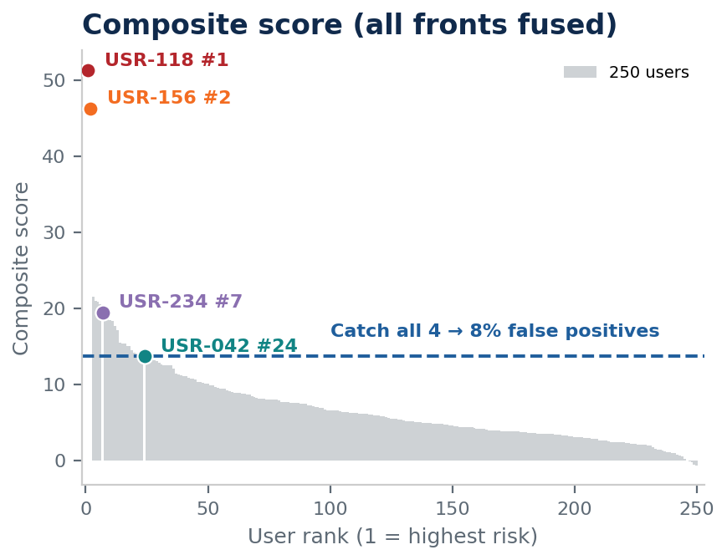
Vector Intelligence: per-week → cumulative drift → composite score
Lead: Ravindra Shukla
Per-week, an attacker resembles a common user; accumulating the signal reveals persistent drift; the composite fuses every front — 4 of 4 caught.
On any given week the stealth APT (USR-234) sits inside the normal range 97% of the time. Accumulating the signal — then fusing every front into one composite score — separates all four attackers from 250 users, at 8% false positives.
Synthetic / representative demo data — to be revalidated on customer SOC data before production claims.
CONFIDENTIAL | 22nd Century Technologies | EDM Vector Intelligence — Cyber UEBA
2

